Slide 1
Restaurant Recommendations in
Las Vegas: An Alternative approach.
Using Data Science to create Useful recommendations

Slide 2

Goal
Create a system which users input restaurants they like, and receive a list of interesting and informative recommendations.
Useful for travelers. Las Vegas has an extensive tourism industry.
Capable of making recommendations with sparse data Give people a reason to care.
Intelligent Provides user with information that is difficult to find by traditional means.

Slide 3
4 GB, 679540 REVIEWS for 4093 RESTAURANTS from 260014 USERS
Restaurant information:
[Alcohol, GoodForKids, Parking...]
Attributes contained practical information about the restaurant environment and features.
[Pizza, Seafood, Steakhouse...]
Category included information about cuisine, ambience, and other subjective information.
Users:
Ratings for restaurants
Total number of reviews each user generated
Review text data
The Data Set
Notes:
Attributes contained practical information about the restaurant environment and features.
We had ratings and text data from reviews from which we could derive informative relations between restaurants.

Slide 4
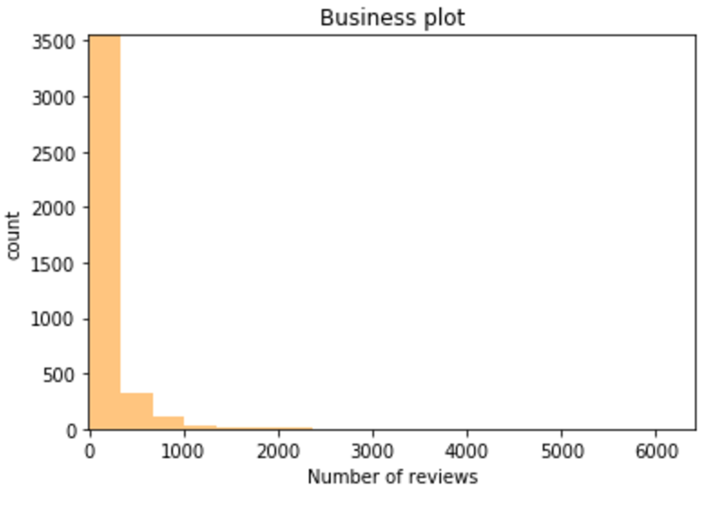
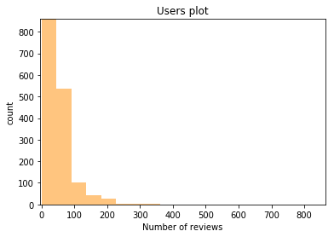
Highly Sparse Matrix
Few Active Users
Median number of reviews each restaurant received:
50
Median number of reviews each user generated:
1

Slide 5

Focus on TOP 1% active users
Users who reviewed 20+ restaurants
Covered 92% restaurants

Slide 6

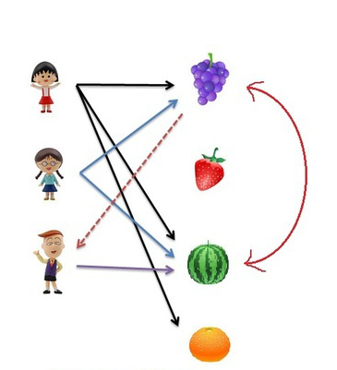
Item-Based Collaborative Filtering Calculate correlation between each pair of restaurants by observing all the users who have rated both restaurants

Slide 7
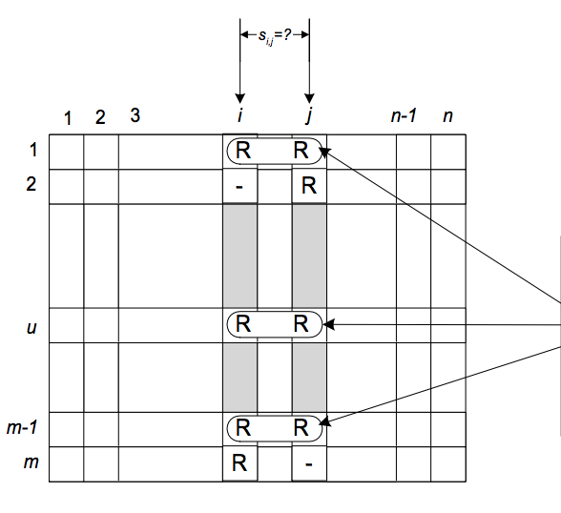
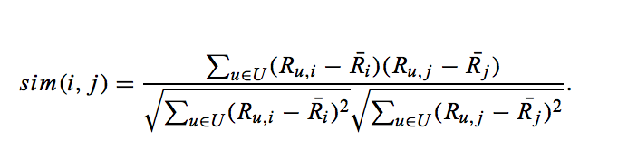
Co-rated items
Correlation-based Similarity
Notes:
Item-item similarity is computed by looking into co-rated items only. In case of items i and j the similarity si,j is computed by looking into them. Note: each of these co-rated pairs are obtained from different users, in this example they come from users 1, u and m-1

Slide 8
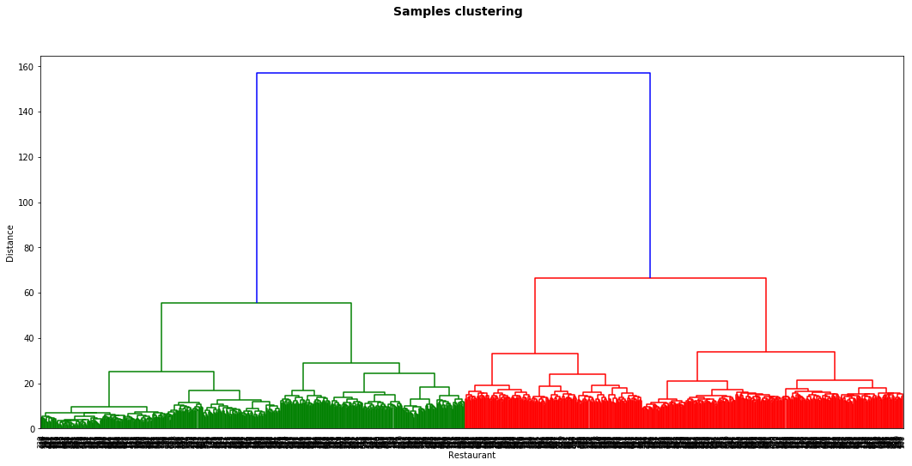
Clustering!

Slide 9
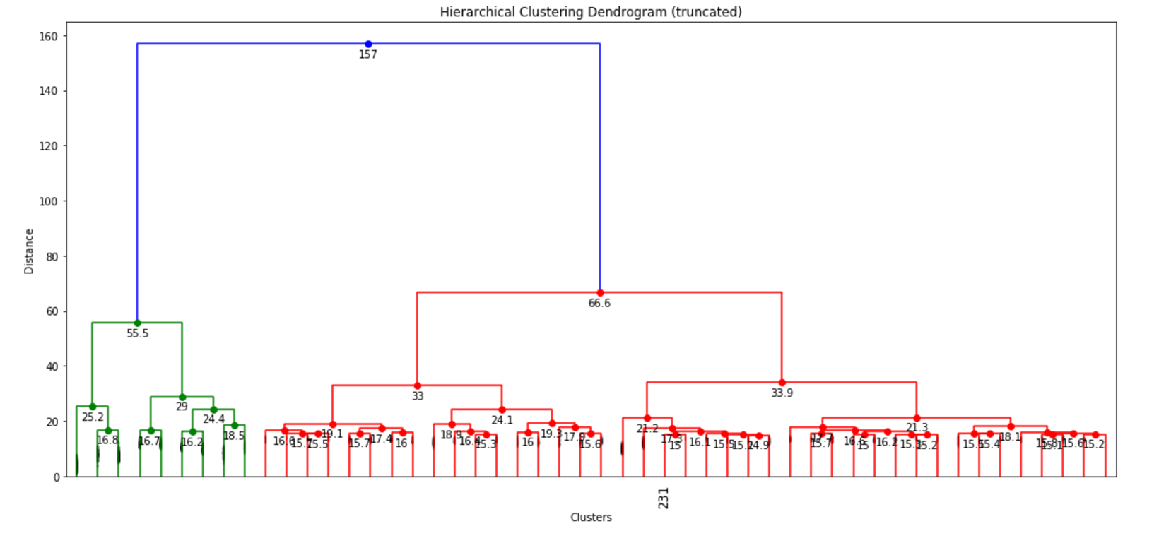
Clustering!

Slide 10
Content Based Recommendation
Category Data:
Euclidean
Distance
Attribute Data:
Binary Information about Features.
Review Text:
TF IDF

Slide 11
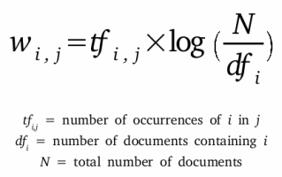
Text Data
Remove numbers, punctuation and stop-words using NLTK.
Stem and Lemmatize to recognize semantically identical words.
Having to Hav.
Am to be.
Extract top 1,000 words.
SKLearn to vectorize and analyze similarity.

Slide 12
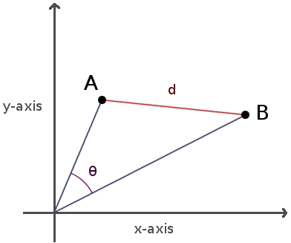
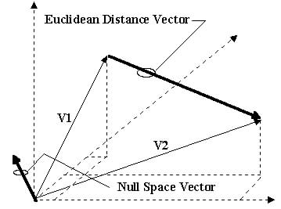
Category Data
Hundreds of categories.
Binarized and analyzed as pre-processed text data using cosine similarity
Attribute Data
List of attributes about each restaurant.
Common length and structure made Euclidean distance an effective measurement.

Slide 13
Results were… Good?ood?
At this point in time, we thought we were going to proceed to build machine learning models to decide which restaurants to recommend.
That approach was fundamentally wrong.
Pinpointing clusters of restaurants in a similar vector space does not meet our established objectives.
Provided uninteresting homogenous results.

Slide 14
Rethinking Our Methods
Techniques we used pinpointed close items in a vector space.
A list of similar restaurants is useless.
New goal:
Create a list that offers Novelty.
Helps user Explore vector space.
Identify unexplored areas of the vector space that may be interesting given user history.

Slide 15
Product
Novel hybrid recommendation system that incorporates collaborative filtering, expert user identification, and arbitrary multidimensional similarity to help users explore new types of restaurants at the periphery of their established interests.
Picks top recommendations based on multiple levels of similarity.
Offers clusters to dig deeper into individual categories.
Weights popular, highly rated, and highly rated by serial reviewers.

Slide 16
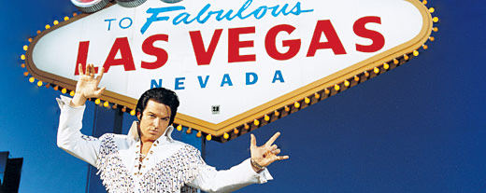
Demo

